Slide 1
Chapter 6 Basic SQL

Slide 2
- SQL Data Definition and Data Types - Specifying Constraints in SQL - Basic Retrieval Queries in SQL - INSERT, DELETE, and UPDATE Statements in SQL - Additional Features of SQL
Content

Slide 3
Introduction about SQL
SQL: Structured Query Language.
Originally, SQL was called SEQUEL (Structured English QUEry Language) and was designed and implemented at IBM Research as the interface for an experimental relational database system called SYSTEM R.
SQL is now the standard language for commercial relational DBMSs.
SQL is a comprehensive database language: It has statements for data definitions, queries, and updates. Hence, it is both a DDL and a DML.
It has facilities for defining views on the database, for specifying security and authorization, for defining integrity constraints, and for specifying transaction controls.

Slide 4
SQL Data Definition and Data Types
SQL uses the terms table, row, and column for the formal relational model terms relation, tuple, and attribute.
The main SQL command for data definition is the CREATE statement, which can be used to
create schemas,
tables (relations),
domains,
views,
assertions,
and triggers.

Slide 5
SQL Data Definition and Data Types
Schema and Catalog Concepts in SQL
An SQL schema is identified by a schema name and includes an authorization identifier to indicate the user or account who owns the schema, as well as descriptors for each element in the schema.
Schema elements include tables, constraints, views, domains, and other constructs (such as authorization grants) that describe the schema.
A schema is created via the CREATE SCHEMA statement, which can include all the schema elements’ definitions.
For example, the following statement creates a schema called “COMPANY” owned by the user with authorization identifier ‘Jsmith’.
CREATE SCHEMA COMPANY AUTHORIZATION ‘Jsmith’;

Slide 6
SQL Data Definition and Data Types
Schema and Catalog Concepts in SQL
In addition to the concept of a schema, SQL uses the concept of a catalog—a named collection of schemas.
A catalog always contains a special schema called INFORMATION_SCHEMA, which provides information on all the schemas in the catalog and all the element descriptors in these schemas.
Integrity constraints such as referential integrity can be defined between relations only if they exist in schemas within the same catalog.

Slide 7
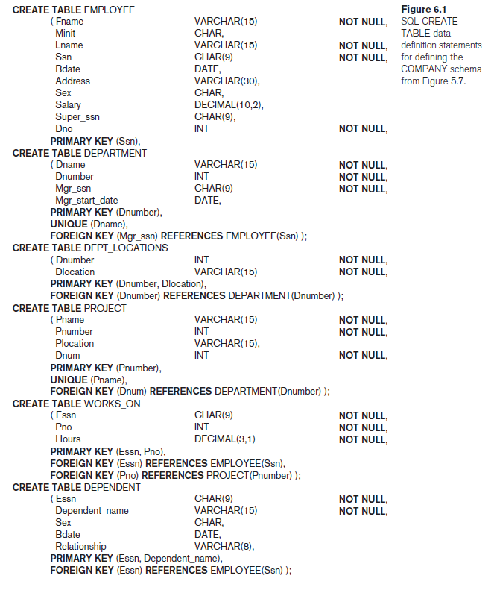
SQL Data Definition and Data Types
The CREATE TABLE Command in SQL
The CREATE TABLE command is used to specify a new relation by giving it a name and specifying its attributes and initial constraints.
The attributes are specified first, and each attribute is given a name, a data type to specify its domain of values, and possibly attribute constraints, such as NOT NULL.
The key, entity integrity, and referential integrity constraints can be specified within the CREATE TABLE statement after the attributes are declared, or they can be added later using the ALTER TABLE command.
Figure 6.1 shows sample data definition statements in SQL for the COMPANY relational database schema.

Slide 8
SQL Data Definition and Data Types
The CREATE TABLE Command in SQL
The relations declared through CREATE TABLE statements are called base tables (or base relations) this means that the table and its rows are actually created and stored as a file by the DBMS.
Base relations are distinguished from virtual relations, created through the CREATE VIEW statement, which may or may not correspond to an actual physical file.
In SQL, the attributes in a base table are considered to be ordered in the sequence in which they are specified in the CREATE TABLE statement. However, rows (tuples) are not considered to be ordered within a table (relation).
It is important to note that in Figure 6.1, there are some foreign keys that may cause errors because they are specified either via circular references or because they refer to a table that has not yet been created.
For example, the foreign key Super_ssn in the EMPLOYEE table is a circular reference because it refers to the EMPLOYEE table itself. The foreign key Dno in the EMPLOYEE table refers to the DEPARTMENT table, which has not been created yet.

Slide 9
SQL Data Definition and Data Types
The CREATE TABLE Command in SQL
To deal with this type of problem, these constraints can be left out of the initial CREATE TABLE statement, and then added later using the ALTER TABLE statement .
The attributes are specified first, and each attribute is given a name, a data type to specify its domain of values, and possibly attribute constraints, such as NOT NULL.
The key, entity integrity, and referential integrity constraints can be specified within the CREATE TABLE statement after the attributes are declared, or they can be added later using the ALTER TABLE command.

Slide 10
SQL Data Definition and Data Types
Attribute Data Types and Domains in SQL
The basic data types available for attributes include numeric, character string, bit string, Boolean, date, and time.
Numeric data types include integer numbers of various sizes (INTEGER or INT, and SMALLINT) and floating-point (real) numbers of various precision (FLOAT or REAL, and DOUBLE PRECISION). Formatted numbers can be declared by using DECIMAL(i, j)—or DEC(i, j) where i, the precision, is the total number of decimal digits and j, the scale, is the number of digits after the decimal point.
Character-string data types are either fixed length—CHAR(n) or CHARACTER(n), where n is the number of characters—or varying length— VARCHAR(n) or CHAR VARYING(n) or CHARACTER VARYING(n), where n is the maximum number of characters.
Bit-string data types are either of fixed length n—BIT(n)—or varying length— BIT VARYING(n), where n is the maximum number of bits. The default for n, the length of a character string or bit string, is 1.

Slide 11
SQL Data Definition and Data Types
Attribute Data Types and Domains in SQL
The basic data types available for attributes include numeric, character string, bit string, Boolean, date, and time.
A Boolean data type has the traditional values of TRUE or FALSE. In SQL, because of the presence of NULL values, a three-valued logic is used, so a third possible value for a Boolean data type is UNKNOWN.
The DATE data type has ten positions, and its components are YEAR, MONTH, and DAY in the form YYYY-MM-DD. The TIME data type has at least eight positions, with the components HOUR, MINUTE, and SECOND in the form HH:MM:SS.
A timestamp data type (TIMESTAMP) includes the DATE and TIME fields, plus a minimum of six positions for decimal fractions of seconds and an optional WITH TIME ZONE qualifier.
Domain can be declared, and the domain name can be used with the attribute specification.
For example, we can create a domain SSN_TYPE by the following statement: CREATE DOMAIN SSN_TYPE AS CHAR(9);

Slide 12
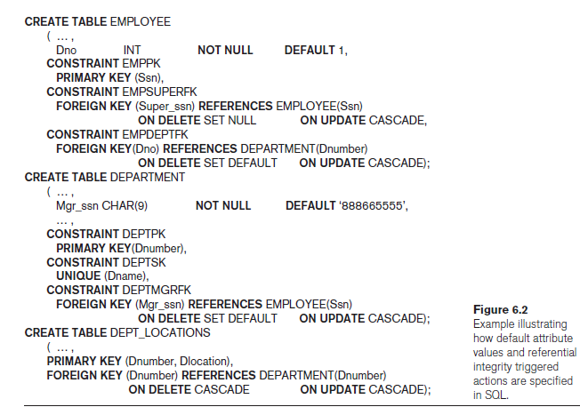
Specifying Constraints in SQL
Specifying Attribute Constraints and Attribute Defaults
Because SQL allows NULLs as attribute values, a constraint NOT NULL may be specified if NULL is not permitted for a particular attribute.
It is also possible to define a default value for an attribute by appending the clause DEFAULT <value> to an attribute definition. The default value is included in any new tuple if an explicit value is not provided for that attribute.
Figure 6.2 illustrates an example of specifying a default manager for a new department and a default department for a new employee.
If no default clause is specified, the default value is NULL for attributes that do not have the NOT NULL constraint.

Slide 13
Specifying Constraints in SQL
Specifying Attribute Constraints and Attribute Defaults
Another type of constraint can restrict attribute or domain values using the CHECK clause following an attribute or domain definition.
For example, suppose that department numbers are restricted to integer numbers between 1 and 20; then, we can change the attribute declaration of Dnumber in the DEPARTMENT table.
Dnumber INT NOT NULL CHECK (Dnumber > 0 AND Dnumber < 21);
The CHECK clause can also be used in conjunction with the CREATE DOMAIN statement.
For example, we can write the following statement:
CREATE DOMAIN D_NUM AS INTEGER
CHECK (D_NUM > 0 AND D_NUM < 21);

Slide 14
Specifying Constraints in SQL
Specifying Key and Referential Integrity Constraints
The PRIMARY KEY clause specifies one or more attributes that make up the primary key of a relation.
If a primary key has a single attribute, the clause can follow the attribute directly. For example, the primary key of DEPARTMENT can be specified as follows: Dnumber INT PRIMARY KEY.
The UNIQUE clause specifies alternate (unique) keys, also known as candidate keys.
The UNIQUE clause can also be specified directly for a unique key if it is a single attribute, as in the following example: Dname VARCHAR(15) UNIQUE.
Schema designer can specify an alternative action to be taken by attaching a referential triggered action clause to any foreign key constraint. The options include SET NULL, CASCADE, and SET DEFAULT. An option must be qualified with either ON DELETE or ON UPDATE.

Slide 15
Specifying Constraints in SQL
Giving Names to Constraints
A constraint may be given a constraint name, following the keyword CONSTRAINT.
The names of all constraints within a particular schema must be unique.
A constraint name is used to identify a particular constraint in case the constraint must be dropped later and replaced with another constraint.

Slide 16
Specifying Constraints in SQL
Specifying Constraints on Tuples Using CHECK
Table constraints can be specified through additional CHECK clauses at the end of a CREATE TABLE statement.
These can be called row-based constraints because they apply to each row individually and are checked whenever a row is inserted or modified.
For example, suppose that the DEPARTMENT table in Figure 6.1 had an additional attribute Dept_create_date, which stores the date when the department was created.
Then we could add the following CHECK clause at the end of the CREATE TABLE statement for the DEPARTMENT table to make sure that a manager’s start date is later than the department creation date.
CHECK (Dept_create_date <= Mgr_start_date);

Slide 17
Basic Retrieval Queries in SQL
The SELECT-FROM-WHERE Structure of Basic SQL Queries
The basic form of the SELECT statement, sometimes called a mapping or a select-from-where block, is formed of the three clauses SELECT, FROM, and WHERE and has the following form:
SELECT <attribute list>
FROM <table list>
WHERE <condition>;
where
<attribute list> is a list of attribute names whose values are to be retrieved by the query.
<table list> is a list of the relation names required to process the query.
<condition> is a conditional (Boolean) expression that identifies the tuples to be retrieved by the query.

Slide 18
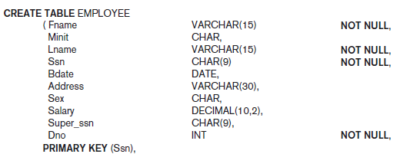

Basic Retrieval Queries in SQL
The SELECT-FROM-WHERE Structure of Basic SQL Queries
Query 0. Retrieve the birth date and address of the employee(s) whose name is ‘John B. Smith’.
Q0: SELECT Bdate, Address
FROM EMPLOYEE
WHERE Fname = ‘John’ AND Minit = ‘B’ AND Lname = ‘Smith’;
The SELECT clause of SQL specifies the attributes whose values are to be retrieved, which are called the projection attributes in relational algebra
and the WHERE clause specifies the Boolean condition that must be true for any retrieved tuple, which is known as the selection condition in relational algebra.

Slide 19
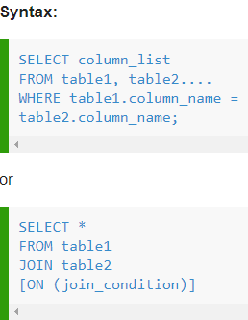
Basic Retrieval Queries in SQL
The SELECT-FROM-WHERE Structure of Basic SQL Queries
SQL EQUI JOIN performs a JOIN against equality or matching column(s) values of the associated tables.
An equal sign (=) is used as comparison operator in the where clause to refer equality.

Slide 20
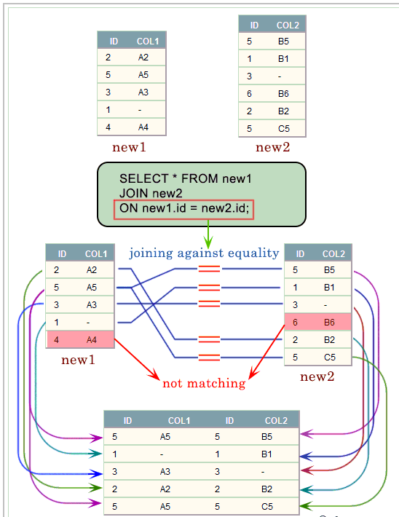
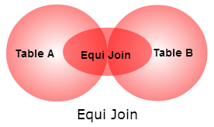
Basic Retrieval Queries in SQL
EQUIJOIN

Slide 21
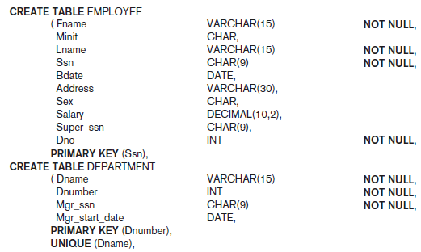
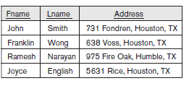
Basic Retrieval Queries in SQL
The SELECT-FROM-WHERE Structure of Basic SQL Queries
Query 1. Retrieve the name and address of all employees who work for the ‘Research’ department.
Q1: SELECT Fname, Lname, Address
FROM EMPLOYEE, DEPARTMENT
WHERE Dname = ‘Research’ AND Dnumber = Dno;
In the WHERE clause of Q1, the condition Dname = ‘Research’ is a selection condition that chooses the particular tuple of interest in the DEPARTMENT table, because Dname is an attribute of DEPARTMENT.
The condition Dnumber = Dno is called a join condition, because it combines two tuples: one from DEPARTMENT and one from EMPLOYEE, whenever the value of Dnumber in DEPARTMENT is equal to the value of Dno.

Slide 22
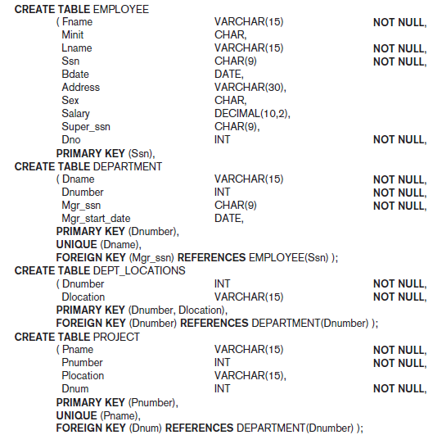

Basic Retrieval Queries in SQL
The SELECT-FROM-WHERE Structure of Basic SQL Queries
Query 2. For every project located in ‘Stafford’, list the project number, the controlling department number, and the department manager’s last name, address, and birth date.
Q2: SELECT Pnumber, Dnum, Lname, Address, Bdate
FROM PROJECT, DEPARTMENT, EMPLOYEE
WHERE Dnum = Dnumber AND Mgr_ssn = Ssn AND
Plocation = ‘Stafford’
The join condition Dnum = Dnumber relates a project tuple to its controlling department tuple, whereas the join condition Mgr_ssn = Ssn relates the controlling department tuple to the employee tuple who manages that department.
Each tuple in the result will be a combination of one project, one department (that controls the project), and one employee (that manages the department).

